Slide 1
SMALL BUSINESS Social Media Workshop

Slide 2
Notes:
Make Fill in the Blank

Slide 3
Becky Chumley, Partner + Director of Digital Marketing
Texas A&M University
BS Technology Management ‘07
MS Education Technology ‘08
Built 350+ websites for small businesses
“All I ever wanted to do was build websites”

Slide 4
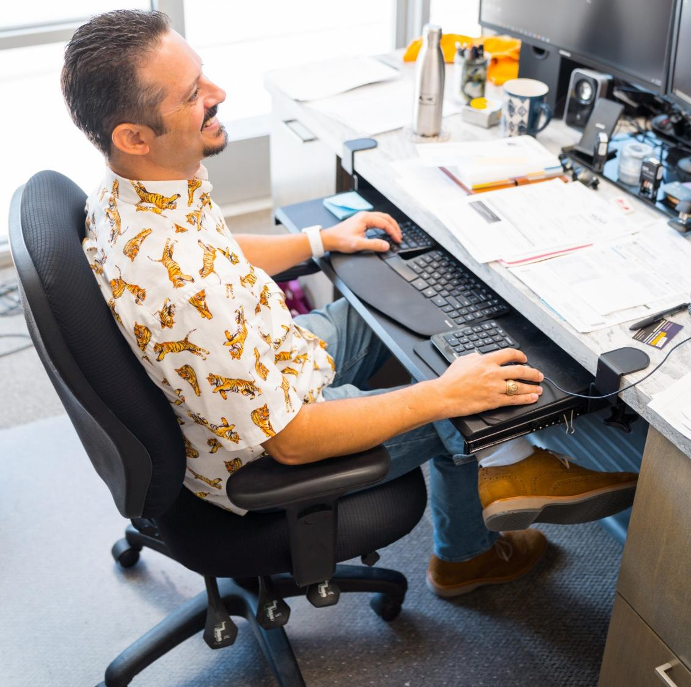
Kevin Crenshaw, Partner + CEO
Texas A&M University
BS Engineering Technology ‘01
Background in software development
19 years website development experience

Slide 5
Raise your Hand If…
Facebook
Instagram
Twitter
LinkedIn
Pinterest
Snapchat
TikTok
MySpace

Slide 6
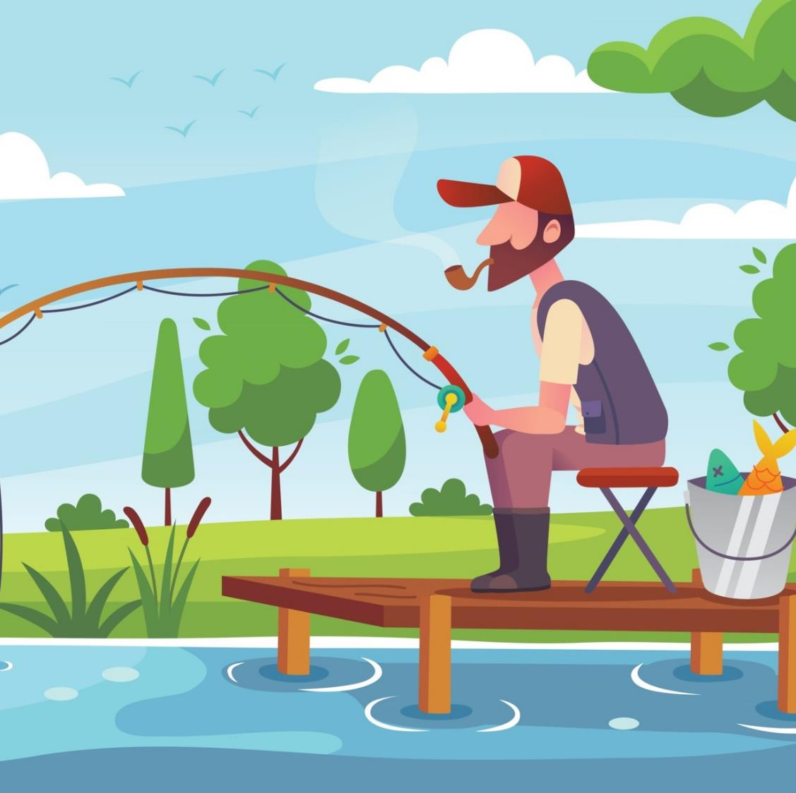
So, You Want to Catch Fish?
Why is marketing like fishing?
ROI is not guaranteed
Strategies change
Work with the variables you have control over
Don’t know anything about fishing?
Hire a guide
Notes:
Who likes to fish? What’d a day of fishing like. What’s 2 days of fishing
You can do the same thing two days in a row with different results.

Slide 7
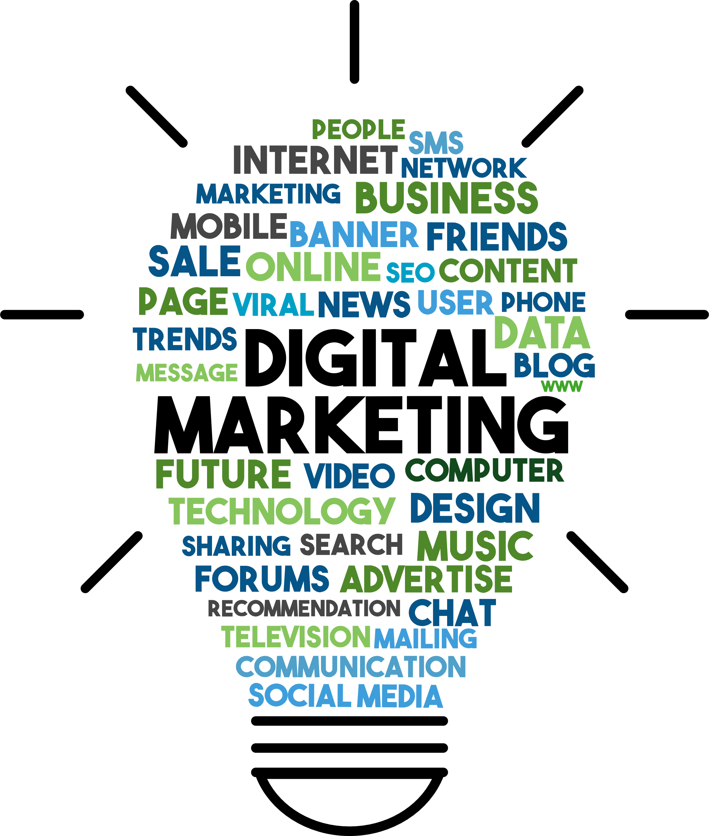
Digital Marketing
Websites
Social Media
Paid Advertising
Google Ads
Meta Ads
Email Marketing
Search Engine Optimization

Slide 8
Marketing & The Business Life Cycle
PUSH
Geofencing
PULL
Reputation Management
Google Local Service Ads
Email Marketing
Social Media Ads
Blog Writing
GROWTH
BUSINESS BUILDING
Search Engine Optimization
Social Media Ads
Google Ads
Social Media Management
LEAD GENERATION
BRAND AWARENESS
Website
IDEA STAGE
Business Cards/Leave Behind
Logo & Branding

Slide 9
Social Media

Slide 10
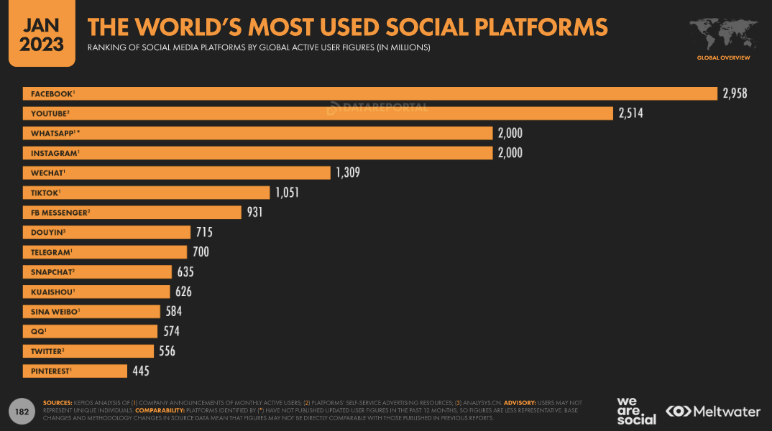

Slide 11
Who Are Your Best Customers
Gender
Age
Income
Location
Unique Characteristics
Who makes the initial contact with you?
Who signs the check?

Slide 12
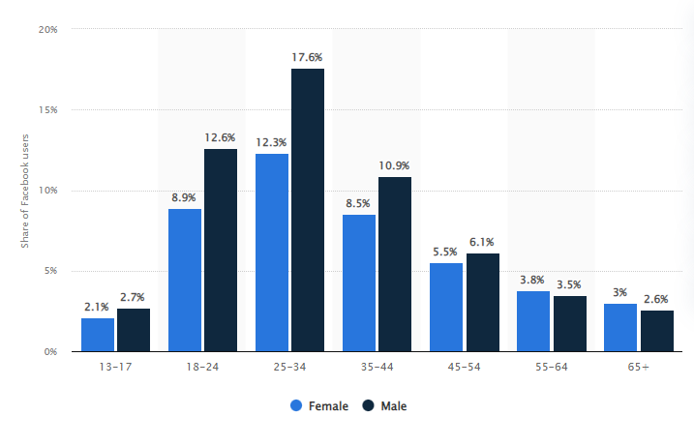
FACEBOOK
Used for Social Networking
Largest Age Group:
25-34 (31.5%)
Gender Breakdown
43% Female
57% Male
Time Spent Per Day:
33 Minutes
Distribution of Facebook users worldwide as of January 2023, by age and gender

Slide 13
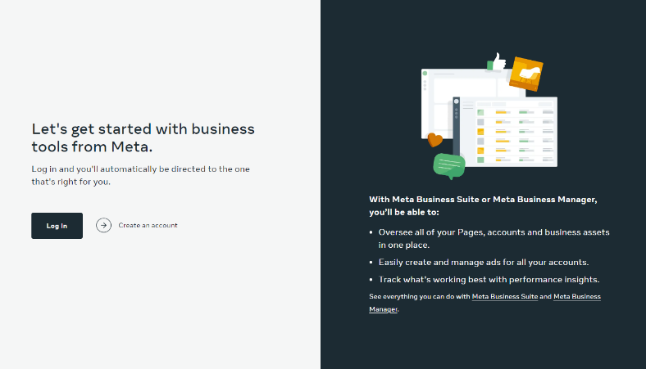
Meta Business Structure
Company Owner Should Setup:
Meta Business Account
Facebook Page
Instagram Page
Ad Account
Pixel
Meta does not make it easy to transfer ownership.
Do it right the first time.
business.facebook.com

Slide 14
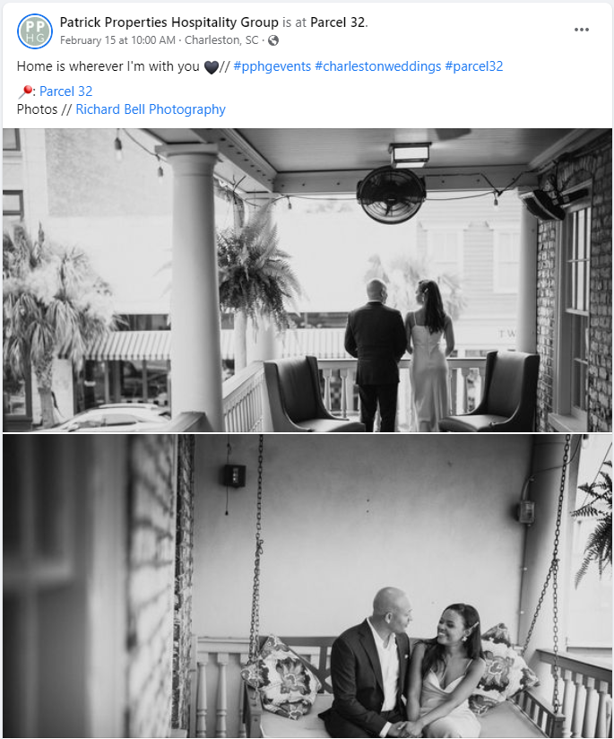
Best Practices: Facebook
Follow 80/20 Rule
80% of posts should be useful to audience
20% promote business
Text should not be more than 20% of the graphic
Make 1/3 posts actionable
eg. share articles, ask for opinions in the comments, etc.
Pin important posts to top of your feed
Use real people in pictures
12-15 words in copy

Slide 15
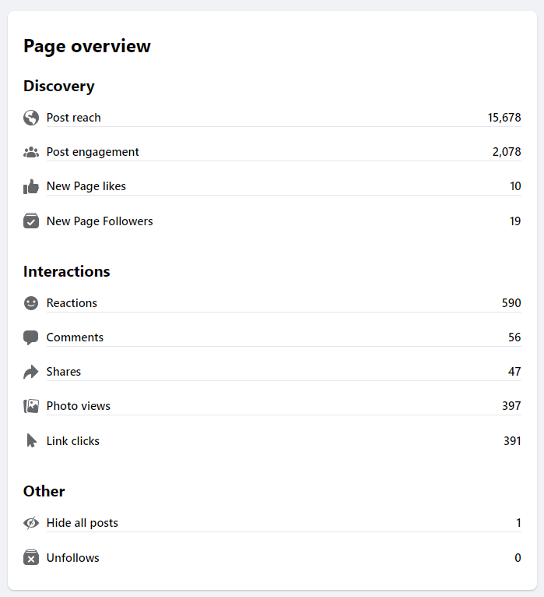
Measuring Success: Facebook
Reach
Engagement
Page Likes
Followers
Reactions
Comments
Shares
Photo Views
Link Clicks

Slide 16
Instagram
Used for Photo Sharing
Largest Age Group:
25-34 (31.2%)
18-24 (31%)
Gender Breakdown:
48.4% Female
51.8% Male
Time Spent Per Day:
29 Minutes

Slide 17
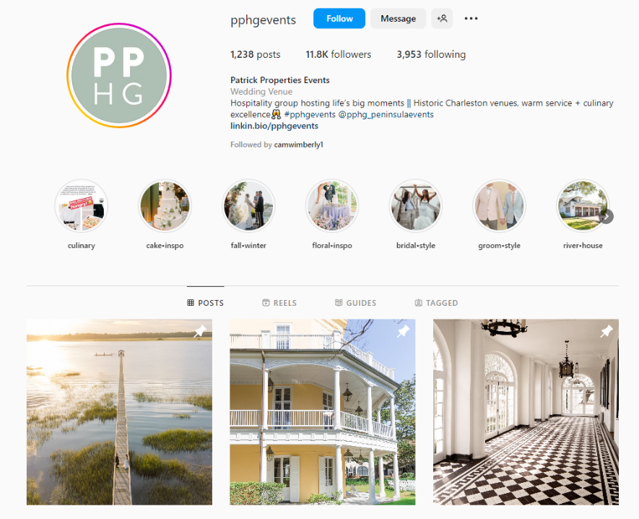
Instagram Business Page
Name = Business Name
Username Instagram.com/impactgroupmarketing
Bio
Website
Category
Email*
Phone Number*
Location*
*Include these if relevant to the business

Slide 18
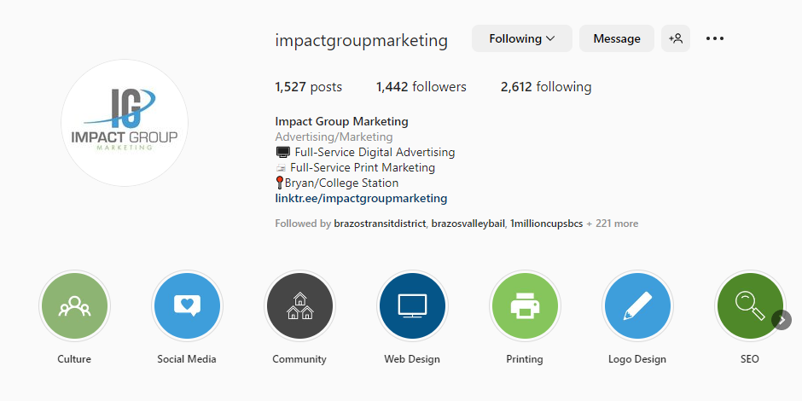
Best Practices: Instagram
Make a “Professional Account”
Use relevant hashtags to expand reach
Post hashtags in first comment
Follow 80/20 Rule
80% of posts should be useful to audience
20% promote business
Ensure that any images used in posts have similar lighting/filters for a consistent look
Include real people in post images when possible
No links in copy – use “link in bio” phrase
Create Instagram Highlights to save stories

Slide 19
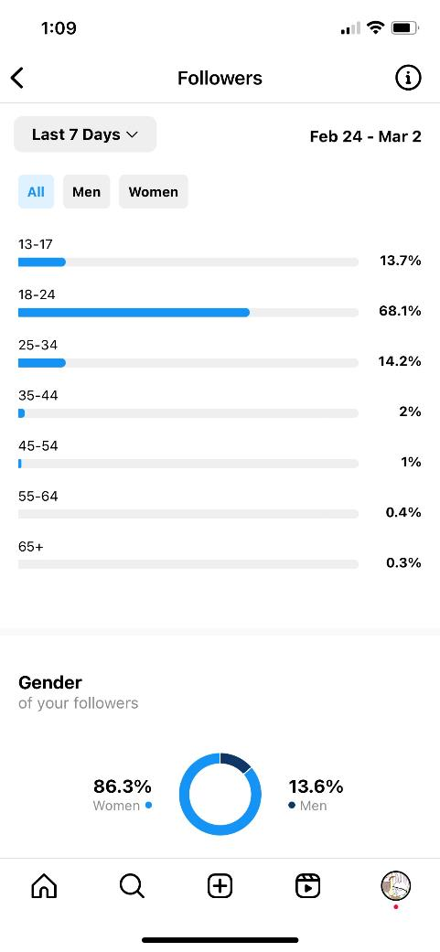
Measuring Success: Instagram
Reach
Profile Visits
Website Taps
Email Button Taps
Followers
Likes
Comments
Saves
Shares
Plays (Reels)

Slide 20
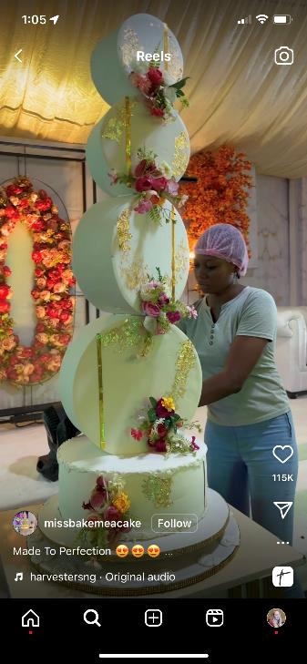
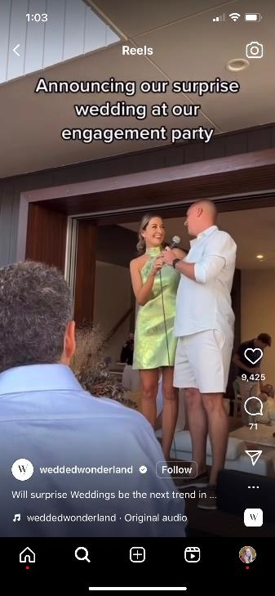
Best Practices: Reels
Show real people
25% higher click-through rate
First 3 seconds are most important
Add text and optimize for sound-off viewing
Use trending audio

Slide 21
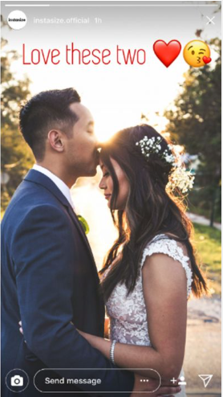
Best Practices: Stories
Use interactive stickers when possible
Question Sticker, Polls, etc.
Add relevant hashtags with the hashtag sticker or through text
Add a location
Add captions when needed and optimize for sound-off viewing
Add trending sounds/music

Slide 22
TikTok
Fastest growing platform
Used for Interactive Media
1 Billion Monthly Active Users
Largest Age Group: 10-19 (25%)
Gender Breakdown
61% Female
39% Male
Time Spent Per Day: 89 Minutes
92% of users globally take action after watching a TikTok video
Distribution of TikTok users worldwide as of January 2023, by age and gender

Slide 23
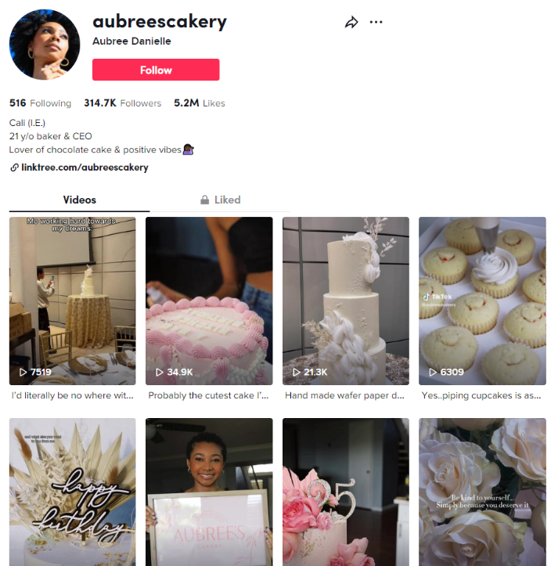
TikTok Business Page
Name = Business Name
Username (tiktok.com/@impactgroupmarketing)
Bio
Website
Category
Email*
Phone Number*
Location*
*Include these if relevant to the business

Slide 24
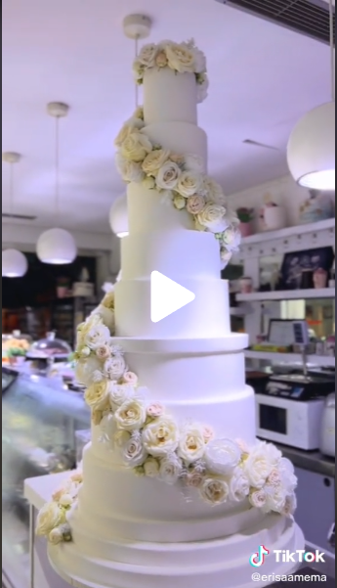
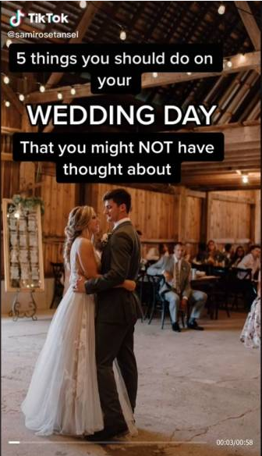
Best Practices: TikTok
Use popular or trending sounds in videos
Make sure videos are watermarked with the brand logo
Ensure that any images or logos used in the video are clear and in optimal resolution and size for TikTok
Utilize titles and turn on captions in videos to ensure that TikTok can recognize what your video is about
Utilize long-tail hashtags in video captions and popular hashtags in comments
Do NOT add #fyp or #foryou on videos
Post when your target audience is active on the platform
Make sure your video thumbnail shows/describes what your video is about

Slide 25
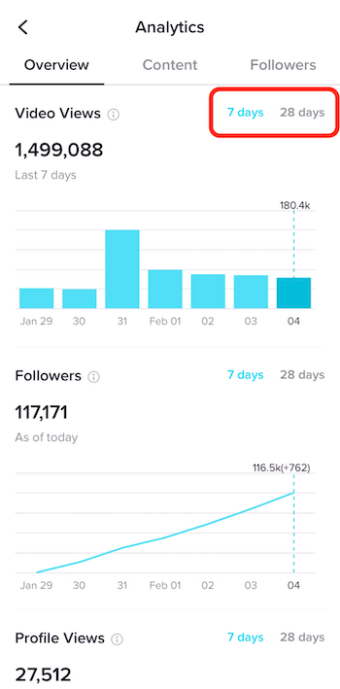
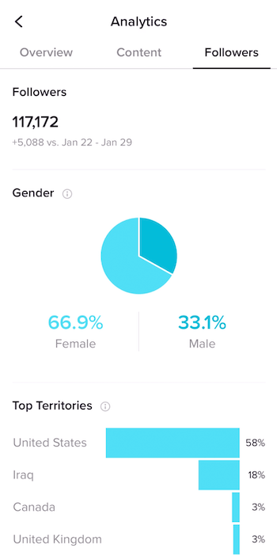
Measuring Success: TikTok
Watch Time
Shares
Comments
Likes
Followers

Slide 26
Sponsored Content

Slide 27
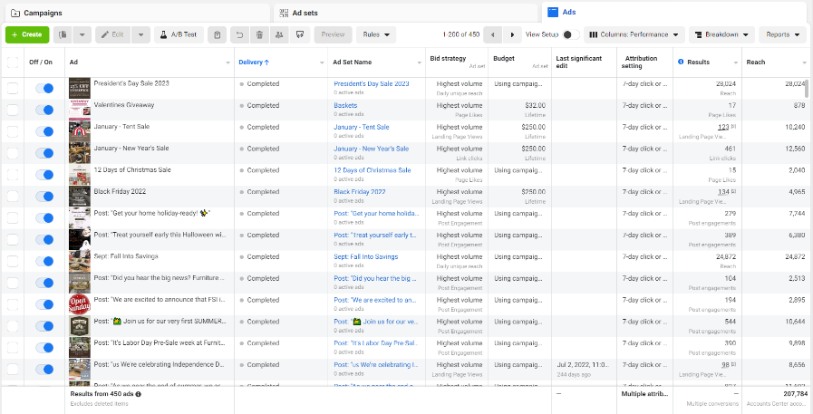
Meta Campaigns
Boosted Post
Goal: More Reach
Uses an Existing Post
Ad Campaigns
Multiple Objectives
Multiple Placements
Multiple Display Options (Carousels, Call to Action Buttons, Etc)
Advanced Targeting
https://business.facebook.com/adsmanager

Slide 28
TikTok Campaigns
ads.tiktok.com
Multiple Demographic Targeting Options
Types of Creative:
Video
Image
Hashtag Challenge
Campaign Objectives
Awareness
Show your ads with the maximum number of impressions in your targeted audience at the most efficient price.
Consideration
Drive people to any URL, such as your website's landing page, a blog post, an app, etc.
Conversion
Product sales, website conversions, app downloads

Slide 29
Measuring Success

Slide 30
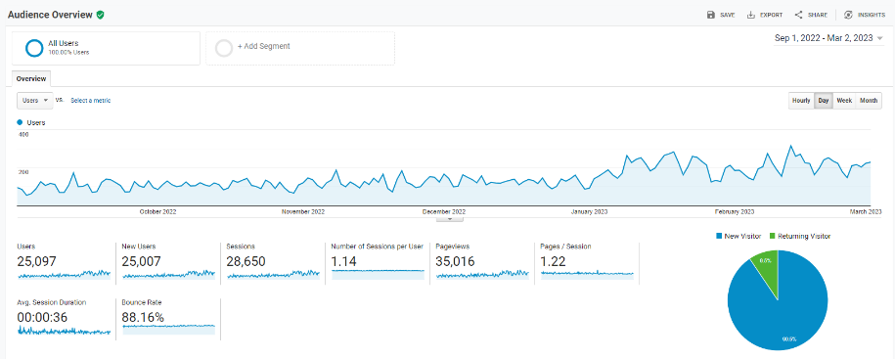
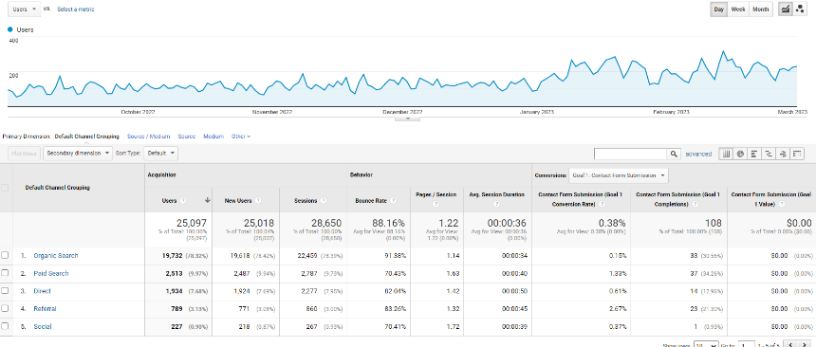
Measure Marketing Success
Google Analytics 4

Slide 31
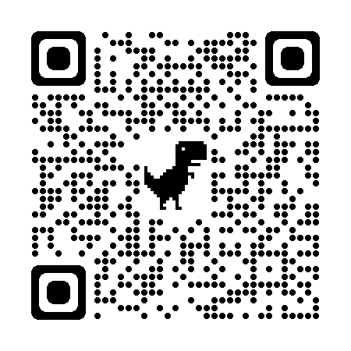
Connect with Us!
Becky Chumley
Kevin Crenshaw

